Slide 1
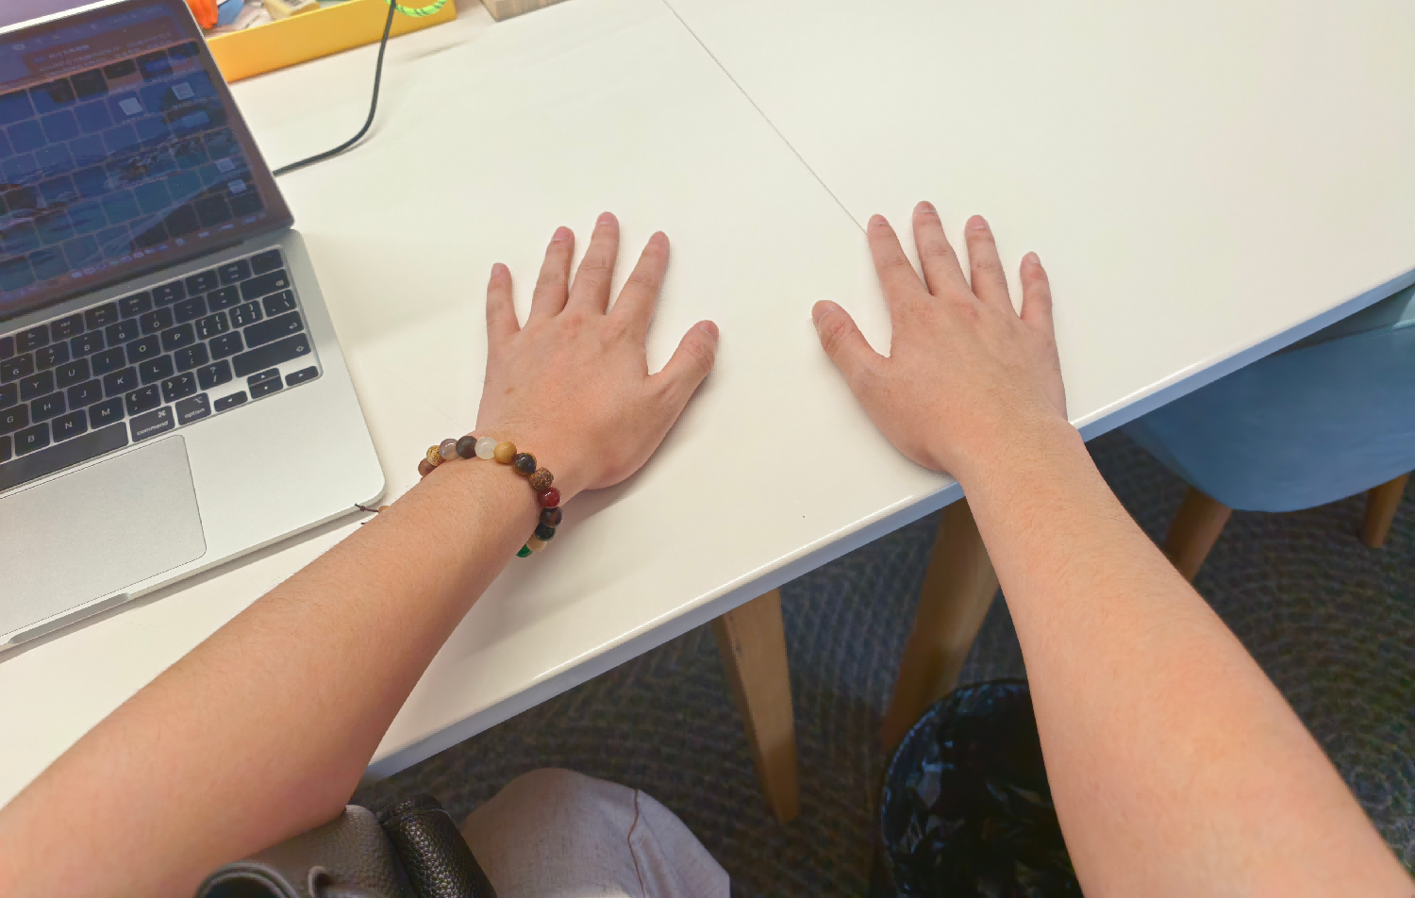
Ego Canonical Frame Definition
The canonical coordinate system of the camera is defined as follows for the view frustum and forward-facing direction: Z (blue) points forward, X (red) points right, and Y (green) points down.
In the direction of the view frustum, when the hands are placed flat, the wrist coordinate system should also satisfy: Z (blue) points forward, X (red) points right, and Y (green) points down.
z
z
x
x
y
y

Slide 2
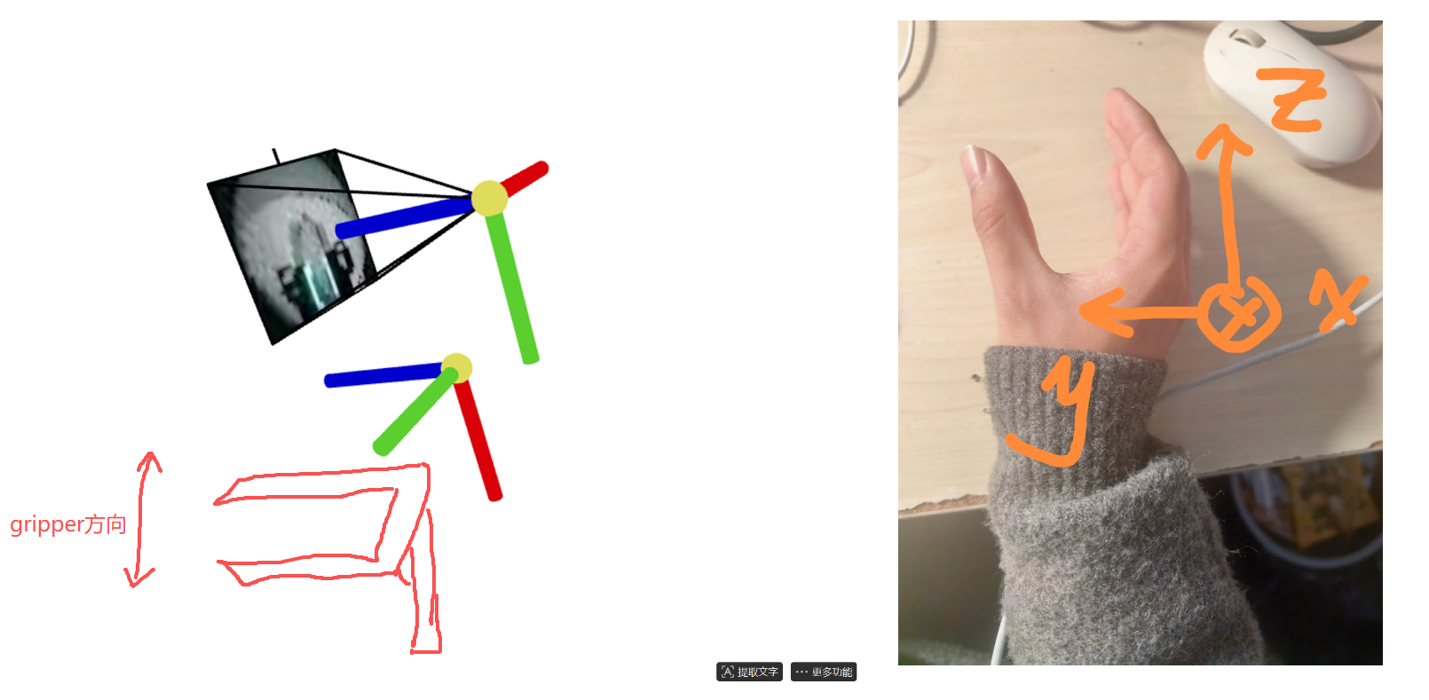
Definition of the Gripper's Ego Canonical Coordinate System
Definition of the Camera's Canonical Coordinate System: For the view frustum and forward-facing direction, the camera's canonical coordinate system is defined with the Z-axis (blue) pointing forward, X-axis (red) pointing right, and Y-axis (green) pointing down.
For the egocentric data of the gripper itself, we approximate the gripper using the human hand grasping posture in the figure below.

Slide 3
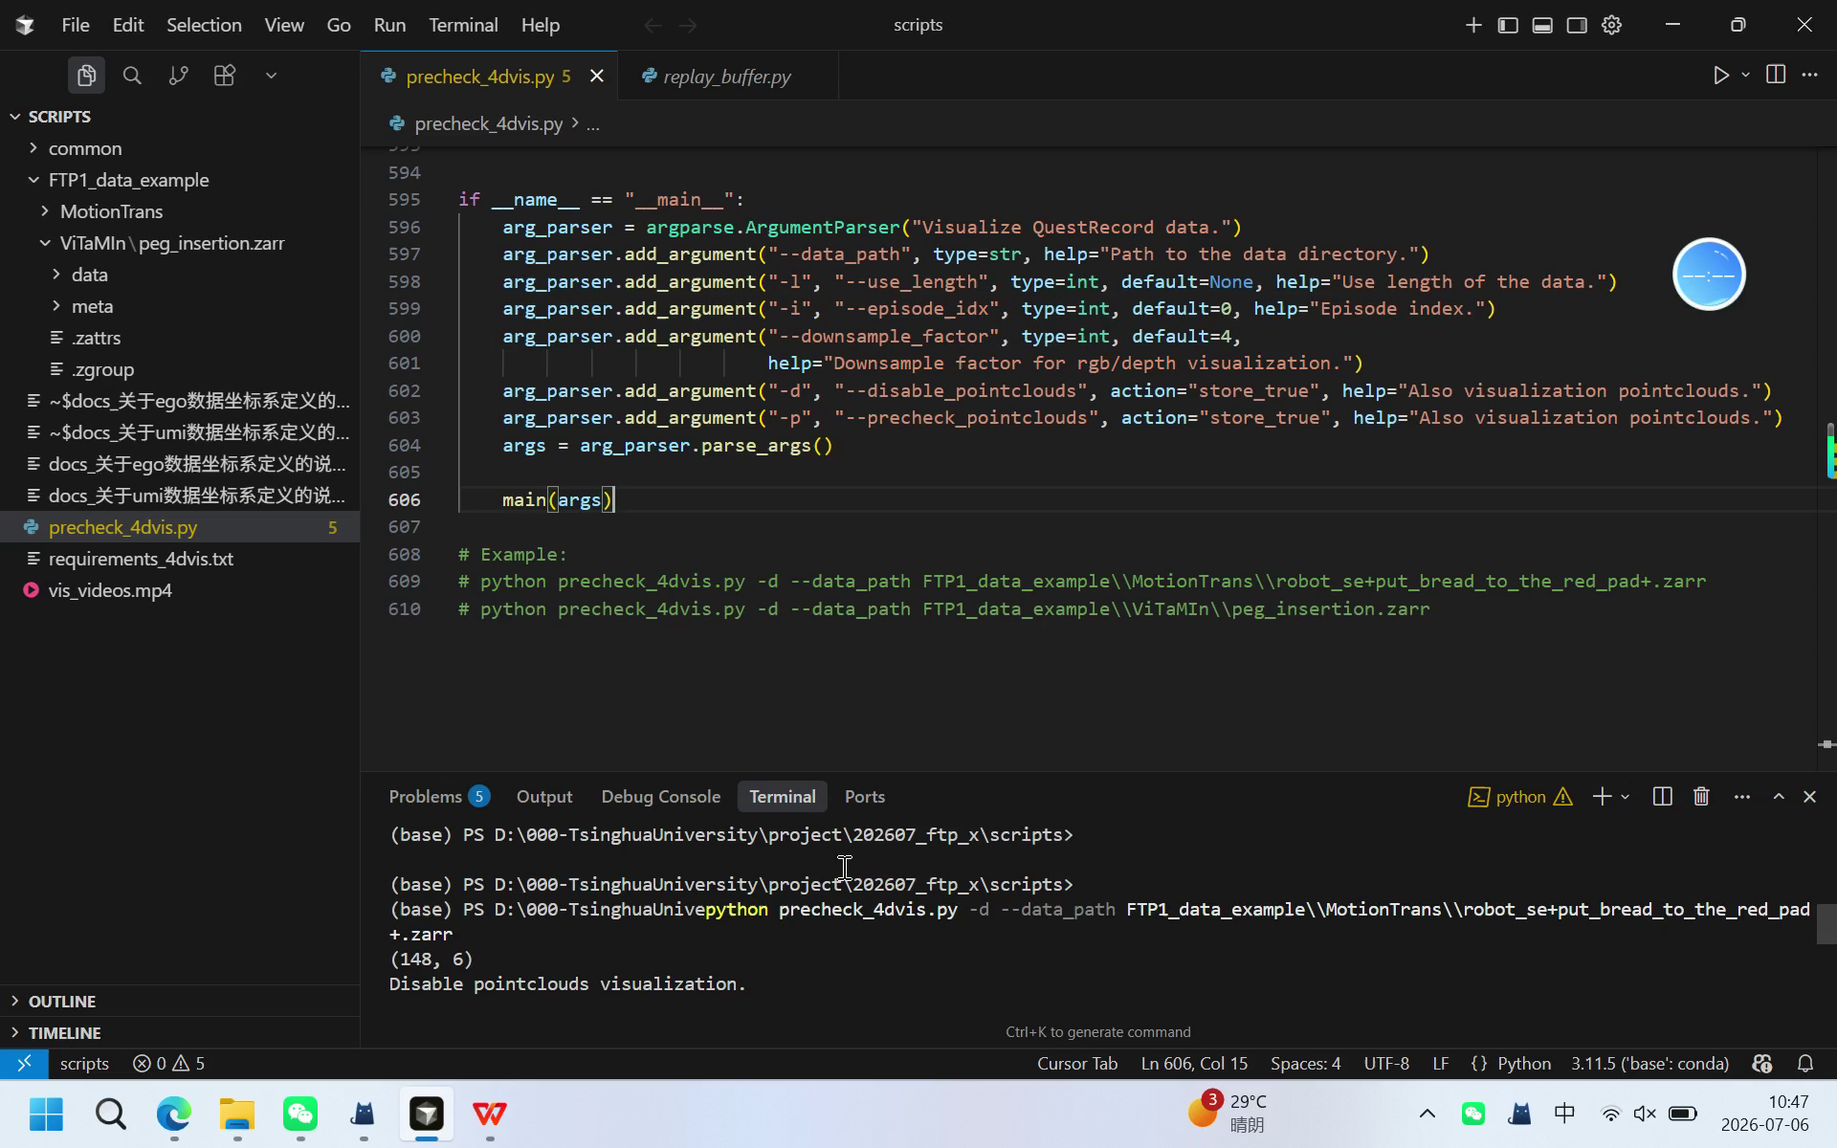
How to check?
(Video available on the right side)
Run precheck_4dvis.py
Switch to a "camera forward" perspective in Viser, and click "Playing" to change to manual playback.
Then drag the progress bar to check whether the movement trend of the gripper coordinate below matches the trend in the video.
For example, in the right-side case, the movement trend of the gripper coordinate relative to the initial position is forward, then left, and then backward, which matches the video.
Also, make sure to check whether the definition of the Wrist Pose matches the canonical coordinate definition on the previous page when the "camera is forward".

